Slide 1
Secure Routing in Wireless Sensor Networks: Attacks and Countermeasures
Seoul National University
Yi Changjae, Mari-Liis Oldja

Slide 2
01
Introduction
Introduction and Background on Sensor Network Security
02
Attacks on sensor networks
CONTENTS
Assumptions and categories of attacks
03
Attacks on specific sensor network protocols and Countermeasures
…
04
Conclusion
Take aways

Slide 3
01
Introduction
Introduction and Background on Sensor Network Security
02
Attacks on sensor networks
CONTENTS
Assumptions and categories of attacks
03
….
……
04
Conclusion
Take aways

Slide 4
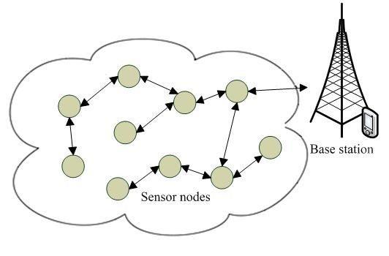
Intro
It is predicted that large scale deployment of wireless sensor networks will only continue to grow in the future. The devices used in sensor networks are expected to eventually be small and inexpensive enough to deploy on very large scale.
Some of the potential applications include:
Environmental - Energy management
Medical - Inventory control
Habitat monitoring - Home and building automation
Military warfare
Wireless communication is inherently insecure and sensor nodes have slow processors and are limited in memory, energy and storage.

Slide 5
Intro
Sensor network routing protocols generally optimize for the limited capabilities of the nodes and application specific nature. None have been designed with security as a goal.
Designing a secure routing protocol is non trivial:
Defender:
Insecure wireless communication
Limited node capabilities
Possible insider threats
Attacker:
Can use powerful laptops with high energy
Long range communication
It is unlikely that a protocol that has not been designed with security in mind can be made secure by adding measures after the fact.

Slide 6
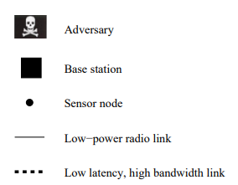
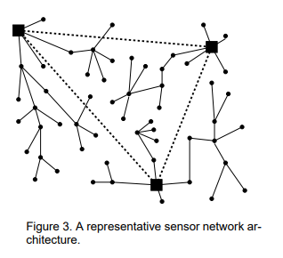
Background
Sensor network
Heterogeneous system combining tiny sensors and actuators with general-purpose computing elements
May consist of hundreds of thousands of low-power, low-cost nodes
Possibly mobile
Deployed in large numbers to monitor and affect the environment
Base station
Point of centralized control (one or more)
Typically represents
Gateway to another network
Powerful data processing or storage center
Access point for human interface
Can be used to disseminate control information into the network or extract data from it.
image made from the survey “A Survey of Adaptive Distributed Clustering Algorithms for Wireless Sensor Networks”
Notes:
Base stations are many orders of magnitude more powerful than sensor nodes.

Slide 7
Background
Normal sensor node
Lower-power, lower-bandwidth short range radios
Form a multi-hop wireless network to communicate with nearest base station
Possible aggregation points
Power management is crucial – should run at around 1% duty cycle (or less) to last a year.
Power consumption of radio is three orders larger when transmitting or listening so sleep mode is crucial
Base station
Many orders of magnitude powerful than sensor node
Workstation or laptop class processors, memory and storage
High bandwidth links for communications amongst themselves
The resource-starved nature of sensor network poses a great challenge for security.
Notes:
Memory around 4KB – cannot maintain much state
Bit transmitted consumes about as much power as 800-1000 instructions – bandwidth is scarce
Power is most limited as it is non-restorable resource
Moores law not helping as the trend is down towards ever cheaper systems while maintaining the performance (fixed performance point)

Slide 8
Ad-hoc vs wireless sensor network
Ad-hoc
Support routing between any pair of nodes
Traditionally considered to have limited resources
Typically have some acknowledgment or validity checks as part of the protocol
Some use public key cryptography
Can use distance vector and source routing protocols
Wireless Sensor network
More specialized communication pattern
Extremely resource constrained – limitations two or three orders of magnitude worse than ad-hoc
Especially power. Intended to be unattended for long periods of times. Battery replacement or recharging unlikely.
High level of trust and cooperation
Must rely on symmetric key cryptography
Local state or packet overhead required to support distance vector and source routing too expensive.
The resource-starved nature of sensor network poses a great challenge for security.
Notes:
distance vector and source routing protocols designed to find routes between all pairs, not relevant in sensor network

Slide 9
01
Introduction
Introduction and Background on Sensor Network Security
02
Attacks on sensor networks
CONTENTS
Assumptions and categories of attacks
03
….
……
04
Conclusion
Take aways

Slide 10
Attacks on Sensor Networks
Assumptions
Radio links are insecure (wireless communication)
Attacker can eavesdrop, inject bits in the channel, replay packets
Adversary likely to be able to deploy multiple malicious nodes
Purchasing the nodes or “turning” legitimate nodes by capturing and overwriting their memory
Attacker might have control of multiple malicious nodes that might collude
Colluding nodes might have high-quality routes to communicate
Sensor nodes are not tamper resistant
After compromising the node adversary can extract all key material, data and code
Base stations are trustworthy
We have to consider both mote-class and laptop-class attackers
Notes:
Laptop class may have more capable CPU, high-power radio transmitter, sensitive antenna for eavesdropping
Mote-class might be the only possible approach if cryptographic key material is embedded deep into tamper resistant processor. In some situations it might just be too difficult to sneak in a laptop class attacker.

Slide 11
Categories of attacks on Sensor Networks
Sensor network routing protocols are simple and thus can be more susceptible to attacks against general ad-hoc routing protocols. Network layer attacks against sensor networks:
Spoofed, altered or replayed routing information
Selective forwarding
Sinkhole attacks
Sybil attacks
Wormholes
HELLO flood attacks
Acknowledgment spoofing

Slide 12
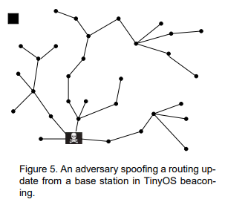
Attacks on sensor networks
Spoofed, altered or replayed information
Means of attack
The most direct attack against routing protocol targets the routing information exchanged between nodes. In this attack the routing information is spoofed, altered or replayed.
Selective Forwarding
Sinkhole attacks
Goal
Create routing loops
Attract or repel network traffic
Extend or shorten source routes
Generate false error messages
Partition the network
Increase end-to-end latency
Sybil attacks
Wormholes
HELLO flood attacks
Acknowledgment spoofing

Slide 13
Attacks on sensor networks
Spoofed, altered or replayed information
Means of attack
Malicious nodes may drop messages stopping them from propagating any further. In a simple form of this attack the node acts as a black hole, no messages get past. In a more subtle form, the adversary forwards packets selectively.
Selective Forwarding
Sinkhole attacks
Sybil attacks
Assumption
Attacker has efficiently included herself on the path of targeted data flow
Wormholes
Goal
HELLO flood attacks
Suppressing or modifying packets originating from a select few nodes
Acknowledgment spoofing
Notes:
We can think of an adversary overhearing a flow passing through neighboring nodes and trying to emulate selective forwarding by jamming or causing collisions on forwarded packets of interest, but the mechanics would be very tricky and may border on impossible.
The next two attacks will cover some means to fill the assumption.

Slide 14
Attacks on sensor networks
Spoofed, altered or replayed information
Means of attack
Make a compromised node look attractive to surrounding nodes in respect to the routing algorithm.
Adversary could spoof or replay an advertisement for extremely high quality route to base station.
Selective Forwarding
Sinkhole attacks
Assumption
Sybil attacks
Protocol used does not verify the quality of route OR
A laptop-class adversary with a powerful transmitter OR
Wormhole is used
Wormholes
Goal
Lure nearly all traffic in the area through compromised node
Packets destined for base station are forwarded through adversary
Selective forwarding becomes trivial
HELLO flood attacks
Acknowledgment spoofing
Notes:
Some protocols verify the quality of route with end-to-end acknowledgments containing reliability or latency information.
Powerful transmitter can actually provide a quality route by transmitting with enough power to reach base station in single hop.
Because of the specialized communication pattern in sensor networks, the base station being the shared ultimate destination, it is especially susceptible to sinkhole attacks. Adversary needs to provide a single high quality route to base station to influence a large number of nodes.

Slide 15
Attacks on sensor networks
Spoofed, altered or replayed information
Means of attack
A single node presents multiple identities to other nodes in the network. Any system whose correct behavior is based on assumption that most nodes will behave properly is at risk.
Selective Forwarding
Sinkhole attacks
Sybil attacks
Especially susceptible
Fault tolerant schemes
Distributed storage
Dispersity and multipath routing
Topology maintenance
Geographic routing protocols
Adversary can “can be in multiple places at the same time”
Wormholes
HELLO flood attacks
Acknowledgment spoofing

Slide 16
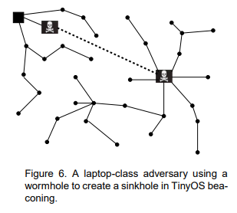
Attacks on sensor networks
Spoofed, altered or replayed information
Means of attack
An adversary tunnels messages received in one part of the network over low latency link and replays them in different part.
Most commonly involving two distant malicious nodes colluding to make distance between them seem shorter by using an out-of-bound channel only available to them.
Selective Forwarding
Sinkhole attacks
Possible Goals
Sybil attacks
Convince nodes normally multiple hops away from base station that they are only one or two hops through wormhole
Create a sinkhole
Convince two distant nodes that they are neighbors
Use in conjunction with selective forwarding, eavesdropping, Sybil
Wormholes
HELLO flood attacks
Acknowledgment spoofing

Slide 17
Attacks on sensor networks
Spoofed, altered or replayed information
Means of attack
In operation of many protocols the nodes will broadcast HELLO packets to announce themselves to their neighbors and nodes receiving the packets assume they are within normal radio range of the sender.
A laptop-class adversary broadcasting with large enough transmission power to all nodes in the network.
Selective Forwarding
Sinkhole attacks
Sybil attacks
Goal
Wormholes
Convince all nodes in the network that adversary is its neighbor
Advertise high quality route to base station – nodes sufficiently far away will send packets to oblivion.
HELLO flood attacks
Acknowledgment spoofing

Slide 18
Attacks on sensor networks
Spoofed, altered or replayed information
Means of attack
Targeting the sensor network routing algorithms that rely on implicit or explicit link layer acknowledgements. Adversary can spoof link layer acknowledgments for overhead packets addressed to neighboring nodes.
Selective Forwarding
Sinkhole attacks
Goal
Sybil attacks
Convince the sender that a weak link is strong or that a dead or disabled node is alive.
Means to achieve selective forwarding
Wormholes
HELLO flood attacks
Acknowledgment spoofing
Notes:
Packets sent on weak or dead links are dropped, encouraging the target node to transmit on such links will achieve selective forwarding.

Slide 19
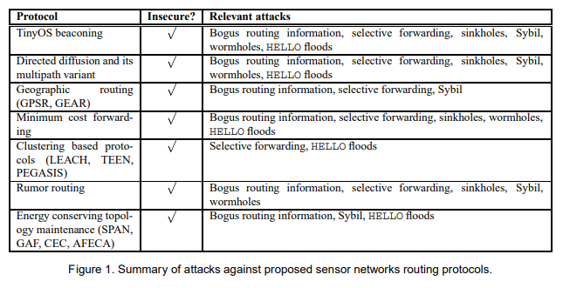
Summary of attacks against proposed network routing protocols

Slide 20
CONTENTS
03
Attacks on specific sensor network protocols and Countermeasures

Slide 21
Attacks on specific sensor network protocols

Slide 22
Attacks on specific sensor network protocols
TinyOS Beaconing
TinyOS:
Lightweight, Event-Driven OS for Sensor Network
Under developed at UC Berkeley

Slide 23
TinyOS
Basic TinyOS Beaconing protocol
Base Station is the final destination of all data packets
Base Station

Slide 24
TinyOS
Basic TinyOS Beaconing protocol
Constructs spanning tree rooted at the base station

Slide 25
TinyOS
Basic TinyOS Beaconing protocol
Periodically and Recursively broadcasts route update
Broadcast

Slide 26
TinyOS
Basic TinyOS Beaconing protocol
Periodically and Recursively broadcasts route update
Child
Parent
Child
Child

Slide 27
TinyOS
Basic TinyOS Beaconing protocol
Periodically and Recursively broadcasts route update

Slide 28
TinyOS
Basic TinyOS Beaconing protocol
Periodically and Recursively broadcasts route update

Slide 29
TinyOS
Basic TinyOS Beaconing protocol
Periodically and Recursively broadcasts route update
3
4
1
2
3
5
6
7
4
1
5
2
7
6

Slide 30
TinyOS
Basic TinyOS Beaconing protocol
All packets received or generated by a node are forwarded to its paraent

Slide 31
TinyOS
Attacks
1) Adversary can claim for being a base station
Routing updates are not authenticated

Slide 32
TinyOS
Attacks
2) Combined wormhole/sinkhole attack
Target Area

Slide 33
TinyOS
Attacks
2) Combined wormhole/sinkhole attack
Broadcast
Routing Update

Slide 34
TinyOS
Attacks
2) Combined wormhole/sinkhole attack
Forwards Routing Update

Slide 35
TinyOS
Attacks
2) Combined wormhole/sinkhole attack

Slide 36
TinyOS
Attacks
2) Combined wormhole/sinkhole attack

Slide 37
TinyOS
Attacks
3) HELLO Flood Attack
Labtop-class adversary

Slide 38
TinyOS
Attacks
3) HELLO Flood Attack
Broadcast

Slide 39
TinyOS
Attacks
3) HELLO Flood Attack
Most of nodes cannot reach its parent due to lack of power
Network is Crippled

Slide 40
TinyOS
Attacks
4) Routing Loop Attack
Routing Update
Src: A
B
A

Slide 41
TinyOS
Attacks
4) Routing Loop Attack
My Parent: A
B
A

Slide 42
TinyOS
Attacks
4) Routing Loop Attack
My Parent: A
B
A
Broadcast
Routing Update

Slide 43
TinyOS
Attacks
4) Routing Loop Attack
My Parent: B
My Parent: A
B
A

Slide 44
TinyOS
Attacks
4) Routing Loop Attack
Because nodes will send every packet to its parent, messages sent to either A or B will be forever forwarded in a loop between them
My Parent: B
My Parent: A
B
A

Slide 45
Directed Diffusion
Directed Diffusion
Data-centric communication paradigm
Draw information out of sensor network
Base Station Floods “Interest” for data
Set up gradients
Nodes satisfy the interest disseminate information in reverse path

Slide 46
Directed Diffusion
Reinforcement
Request at higher frequency to the neighbor sending events
Negative reinforcement also possible

Slide 47
Directed Diffusion
Attacks
1) Suppression
By spoofing negative reinforcement to the nodes

Slide 48
Directed Diffusion
Attacks
2) Cloning
Cloning a flow enables eavesdropping
Replay the interest and mark adversary as base station
Source
interest

Slide 49
Directed Diffusion
Attacks
2) Cloning
Cloning a flow enables eavesdropping
Replay the interest and mark adversary as base station
Replay interest
List itself as base station

Slide 50
Directed Diffusion
Attacks
2) Cloning
Cloning a flow enables eavesdropping
Replay the interest and mark adversary as base station
Source will now send information to both the adversary and the base station

Slide 51
Directed Diffusion
Attacks
3) Path influence
Spoofing Reinforcement
Data events generated upstream by legitimate sources will be drawn through adversary
Alternate event flows will be negatively reinforced by adversary
Adversary will be positively reinforced
As result, any data flow will propagate through the adversary
4) Selective forwarding and data tampering
Use of above attack, by putting adversary in the flow, adversary can modify and selectively forward packets
5) Wormhole/Sinkhole
Labtop-class adversary can exert greater influence by creating a wormhole
6) Sybil Attack

Slide 52
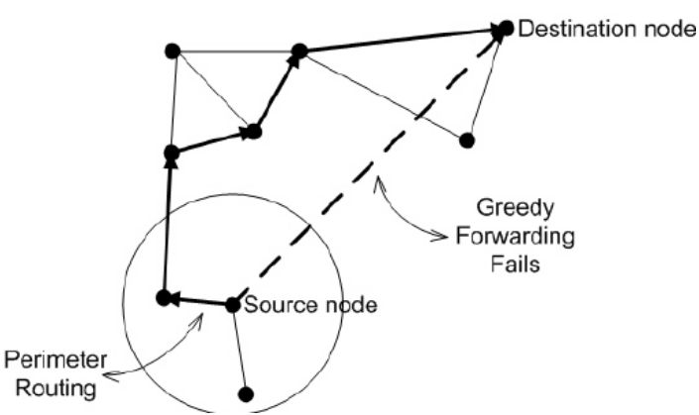
Geographic Routing
Geographic Routing
Greedy Perimeter Stateless Routing (GPSR)
Uses greedy forwarding at each hop
When forwarding fails, GPSR recovers by routing around the perimeter
Drawbacks: likely to use one path, which will lead uneven energy-consumption

Slide 53
Geographic Routing
Geographic and Energy Aware Routing (GEAR)
GEAR considers the remaining energy of the node when forwarding packets
The responsibility for routing a flow is more evenly distributed
Both GEAR and GPSR protocols require location information of nodes

Slide 54
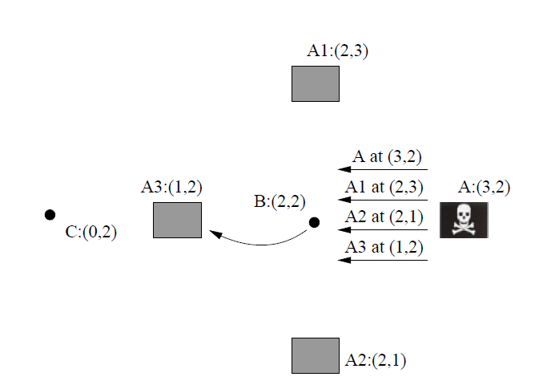
Geographic Routing
The Sybil Attack
Adversary can advertise itself as multiples nodes in different places

Slide 55
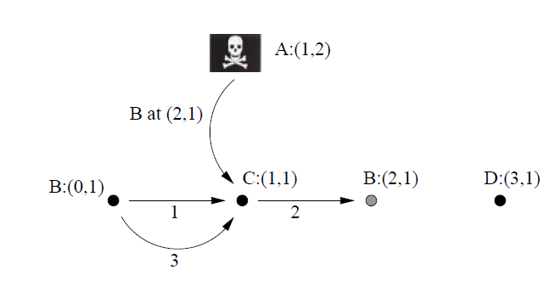
Geographic Routing
Routing Loop Attack
Assume the radio ranges only a unit, and C wants to send packet to D
By fooling the C node that B is at (2,1), C will send packets, but reaching to B at (0,1)
Because B believes C is closer to D, it sends the packet to C

Slide 56
Countermeasures

Slide 57
Outsider Attacks
Outsider Attacks and Link Layer Security
Outsider attacks can be prevented by using Globally Shared Key
1)Spoofing or altering the message
Only packets that has valid authentication code will be noted as friendly packets
Altered message will easily be detected
2)Replaying Packets
Place monotonically increasing counter for each link
Only the packet that has correct counter value will be accepted
3)Sybil Attack, Sinkhole Attack, Selective Forwarding
These attack will fail because the adversary nodes don’t have shared key
Unable to join the topology

Slide 58
The Sybil Attack
The Sybil Attack
If adversary attacks as insider, globally shared key doesn’t help
The attacks can be prevented by implementing public key cryptography
However, this method is beyond capabilities of sensor nodes
Solution:
1) Every node share a unique symmetric key with a trusted base station
2) Between two nodes, verify other’s identity and establish a shared key
3) Use the resulting key to implement authenticated link between them

Slide 59
HELLO Flood Attacks
HELLO Flood Attacks
Solution: verify the bidirectionality of a link

Slide 60
Wormhole/Sinkhole Attacks
Wormhole and Sinkhole Attacks
Very difficult to defend against, especially when the two are used in combination
So have to use routing strategy that makes these attacks meaningless
The geographic routing protocols can be one solution
Because the routing is based on the location, it is difficult to create wormhole and thus sinkhole will also be prevented

Slide 61
01
Introduction
Introduction and Background on Sensor Network Security
02
Attacks on sensor networks
CONTENTS
Assumptions and categories of attacks
03
….
……
04
Conclusion
Take aways

Slide 62
Conclusion
Secure Routing is vital
Currently proposed routing protocols are insecure
Link layer encryption and authentication mechanisms are reasonable to use for mote-class outsiders
But still, not enough to defend the labtop-class adversaries and insiders
Careful design is needed

Slide 63
Thank You
Q & A

